Slide 1
A murine model of glucocorticoid myopathy alleviation using androgen therapy
Nicolae Lucian Sandor
July 13th, 2015

Slide 2
Glucocorticoids in humans
Stress hormones working towards hyperglycemia
Abnormal increase in Cushing’s syndrome.
Activate immunosuppressive mechanisms, such as macrophage apoptosis.
Prescribed to ~1% per annum.
Effects include
osteopenia
insulin resistance
muscle loss.
Less specific glucocorticoids cause edema.

Slide 3
Glucocorticoid myopathy
“Proximal weakness”
Loss of volume, mass, force
Myofiber condition
Increased catabolism:
urinary nitrogen
methylhistidine

Slide 4
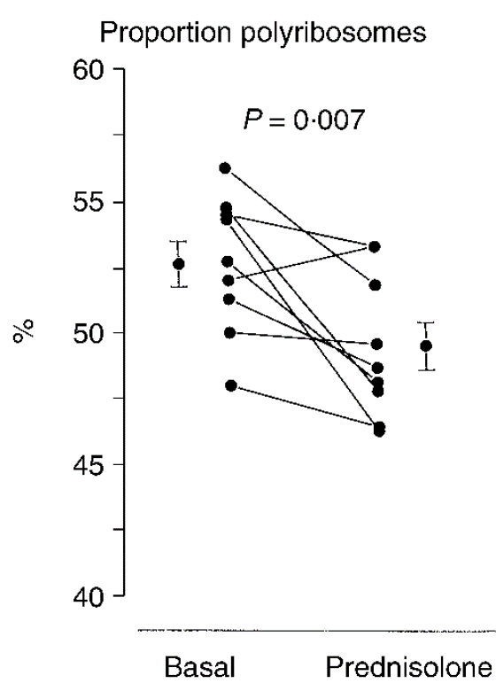
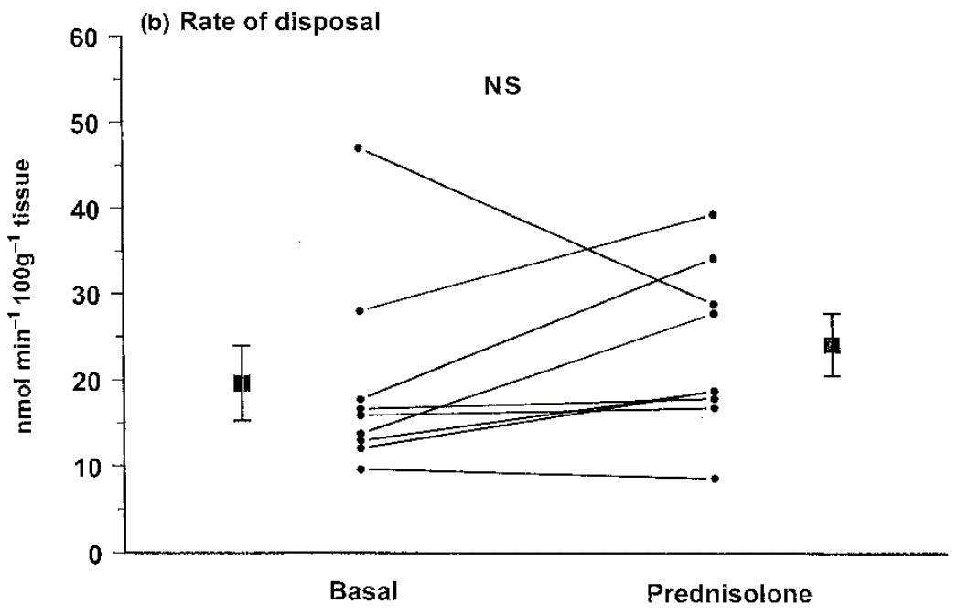
The role of glucocorticoids effect in translation regulation is unclear
Three-day prednisone on healthy volunteers (Lofberg et al., Eur J Clin Invest, 2002)

Slide 5
Therapeutic approaches to GM
Cessation or surgery, if possible.
Receptor blockers.
Anabolic adjuvants.

Slide 6
Why testosterone?
Effective in sarcopenia of aging, HIV+.
Hypercortisolism reduces testosterone.
Anecdotal: was standard of care until 1980’s.
Crawford et al. (2003) showed Testo addition to chronic GC causes:
higher bone density
improved muscle mass and strength
better quality of life.

Slide 7
Why not testosterone?
Females with hypercortisolism have hirsutism.
Males receiving testosterone supplementation might be at higher risk for heart disease, prostate cancer etc.
“Safer” alternatives are desirable.

Slide 8
How is testosterone working?
Higher amino acid uptake in muscle
Some anti-catabolic component
Stimulates intramuscular IGF-I expression.

Slide 9
Animal models
Intramuscular fat is confounding.
Rats are a good model and have been well-studied.
Mice are less studied.

Slide 10
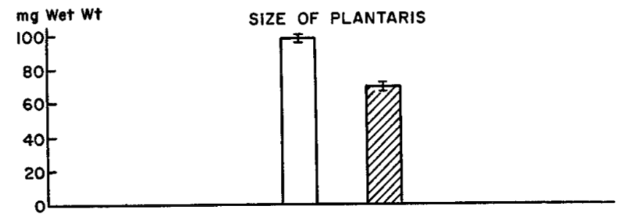
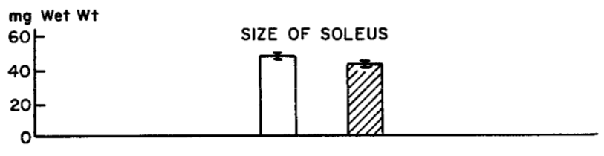
Rats respond to glucocorticoids
Hatched bars for seven-day 10 mg/kg cortisone on adult male rats (Goldberg, JBC, 1969).
Pair-feeding does not change findings.

Slide 11
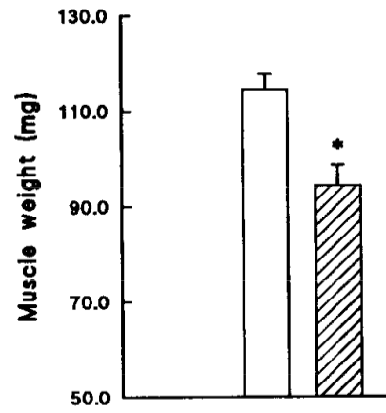
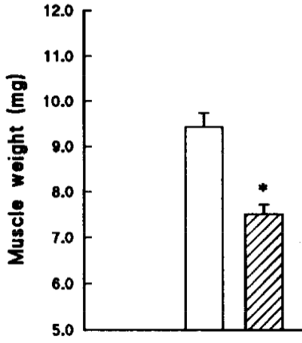
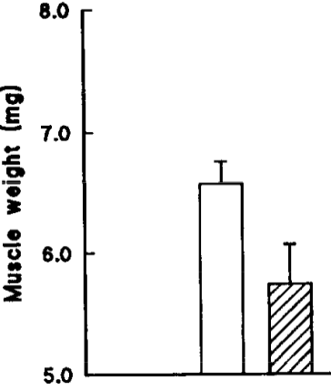
Mice respond to glucocorticoids
Gastrocnemius
Extensor digitorum
Soleus
Hatched bars for ten-day 5 mg/kg dexamethasone on male mice
(Agbenyega et al., Comp Physiol, 1992).

Slide 12
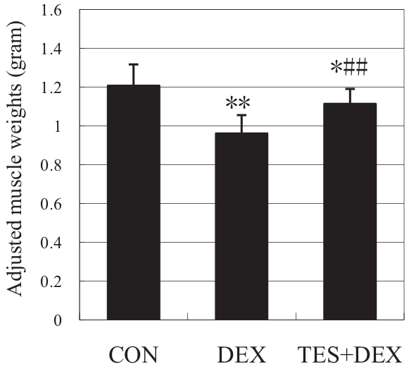
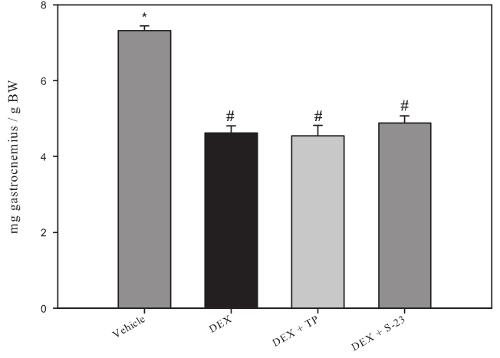
Rat muscles are protected by testosterone co-administration
... Or are they?
Gastrocnemius.
Ten-day 1 mg/kg dexamethasone
± 5 mg/kg testosterone (Yin, J Trauma, 2009).
Gastrocnemius.
Eight-day 0.6 mg/kg dexamethasone
± 25 mg/kg testosterone (Jones, Endocrinology, 2010).

Slide 13
First hypothesis
Testosterone alleviates dexamethasone-induced muscle atrophy in mice.

Slide 14

In vivo test
± 10 mg / kg D, ± 28 mg / kg T
Tissue collection
V
D
Time (days)
D+T
Eight week old, male, C57BL/6.

Slide 15
Progressive loss of body weight is alleviated by testosterone
body weight
(% gain)

Slide 16
Deeper in vivo probe
V
Tissue collection
D
Time (days)
D+T
V
Tissue collection
D
Time (days)
D+T
V
Tissue collection
D
Time (days)
D+T

Slide 17
Net effects on body weight becomes evident when treated for longer
body weight
(% gain)

Slide 18
Testosterone partly restores lean mass
fat mass
gain (g)
lean mass
loss (g)
Only dexamethasone alters fat deposits.
Testosterone effects are more salient in longer-treated group.

Slide 19
Testosterone partly restores individual muscles
gastrocnemius (g)
triceps br. (g)
quadriceps (g)
levator ani (g)
one day
three days
seven days
one day
three days
seven days

Slide 20
Conclusion so far
Testosterone reduces dexamethasone-induced reduction in mouse muscle mass.

Slide 21
Catabolic mechanisms of Dexa in rodents
Increase in urinary 3MH.
Amino acid release decreases by 80% when co-treated with MG132.
E3 ligases upregulated
Other proteolytic mechanisms are involved.

Slide 22
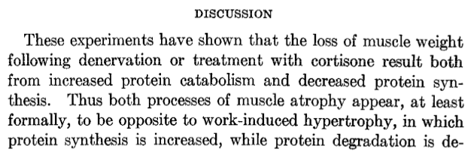
Protein synthesis and Dexa
(Goldberg, JBC, 1969).

Slide 23
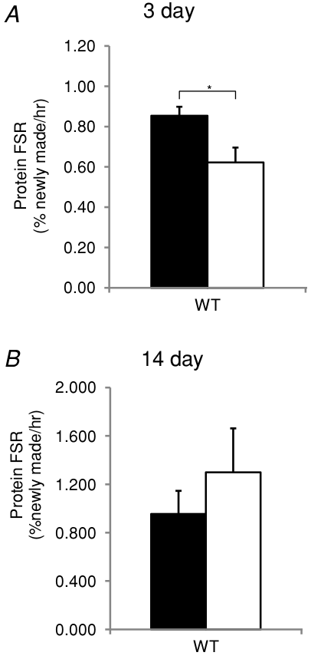
Protein synthesis and Dexa: caveats
3 mg/kg dexamethasone on male mice
(Baehr et al., J Physiol, 2012).
More caveats later.

Slide 24
Testosterone effect on atrophying muscle
Molecular studies in glucocorticoid atrophy, denervation suggest anabolic and anti-catabolic effects.
Anti-proteolytic in rescue of castration (Serra, Sandor, Bhasin, et al., 2012).

Slide 25
Second hypothesis
Because dexamethasone is a strong catabolic stimulus:
In dexamethasone-induced muscle atrophy, testosterone’s myoprotective action must include an anti-catabolic component.

Slide 26
MuRF1 is restored to baseline levels by testosterone co-administration
gastrocnemius MuRF1 mRNA
quadriceps MuRF1 mRNA
gastrocnemius MAFbx mRNA
quadriceps MAFbx mRNA
one day
three days
seven days

Slide 27
Chymotrypsin-like activity correlates with phenotype
quadriceps proteasome catalytic activity (rel.u.)
No ladder pattern of ubiquitinated myosin.
triceps proteasome catalytic activity (rel.u.)
three days

Slide 28
Dexamethasone represses autophagosome-associated genes
gastrocnemius beclin mRNA
gastrocnemius cathepsin L mRNA
gastrocnemius LC3 mRNA
one day
three days
seven days

Slide 29
Cathepsin L activity does not correlate with phenotype
gastrocnemius autophagosome catalytic activity (rel.u.)
quadriceps autophagosome catalytic activity (rel.u.)
triceps autophagosome catalytic activity (rel.u.)
one day
three days
seven days

Slide 30
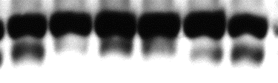

Lipidated LC3 isoform indicates autophagy unchanged
slow >
LC3
fast >
GAPDH
Dexa | - | - | + | + | + | +
Testo | - | - | - | - | + | +
LC3-II normalized to GAPDH
LC3-II normalized to LC3-I
Gastrocnemius, 7 day.
Sub-optimal normalization has been used by others to hypothesize role of autophagy.

Slide 31
Calpain markers did not correlate with the phenotype
gastrocnemius calpain catalytic activity (rel.u.)
one day
three days
seven days
Also, no change in mu-calpain, calpastatin protein levels.

Slide 32
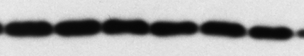
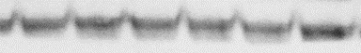

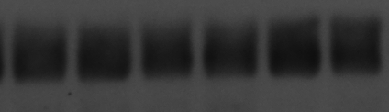
Translation regulators appear unchanged
Ⓟ-eIF2α
eIF3f
GAPDH
GAPDH
Dexa | — | — | + | + | + | +
Testo | — | — | — | — | + | +
Dexa | — | — | + | + | + | +
Testo | — | — | — | — | + | +
Ⓟ-eIF2α
eIF3-f
gastrocnemius, day 7

Slide 33
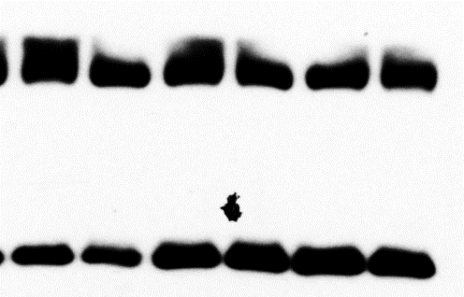
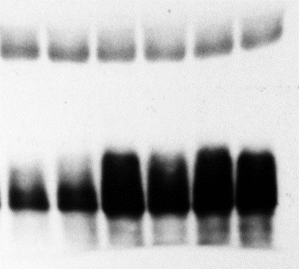
4E-BP is not inhibited by testosterone
GAPDH
GAPDH
Ⓟ-4EBP
total 4EBP
Dexa | — | — | + | + | + | +
Testo | — | — | — | — | + | +
Dexa | — | — | + | + | + | +
Testo | — | — | — | — | + | +
total 4EBP
Ⓟ-4EBP
gastrocnemius, day 7
Could not employ polysome profiling.

Slide 34
Conclusions so far
Dexamethasone-induced loss of muscle is correlated with an increase in proteasome activity and E3 ligases expression.
Rescue by testosterone co-administration is correlated with proteasome repression.
Significant autophagy changes contrast with the phenotype.
Calpains, protein synthesis changes are less correlated with the phenotype.

Slide 35
Glucocorticoids’ transcriptional effect
Myostatin
Klf15
GR
MuRF1
muscle
loss
Dexa
Foxo
4EBP

Slide 36
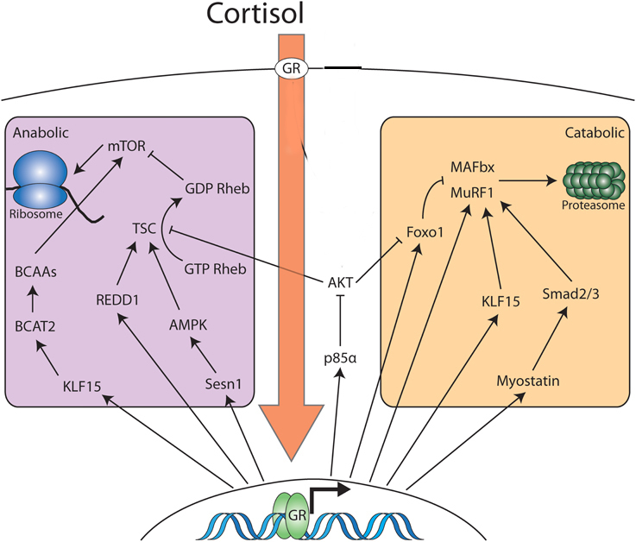
More transcriptional targets of Dexa
Modified from Braun and Jones, Front Physiol, 2015.

Slide 37
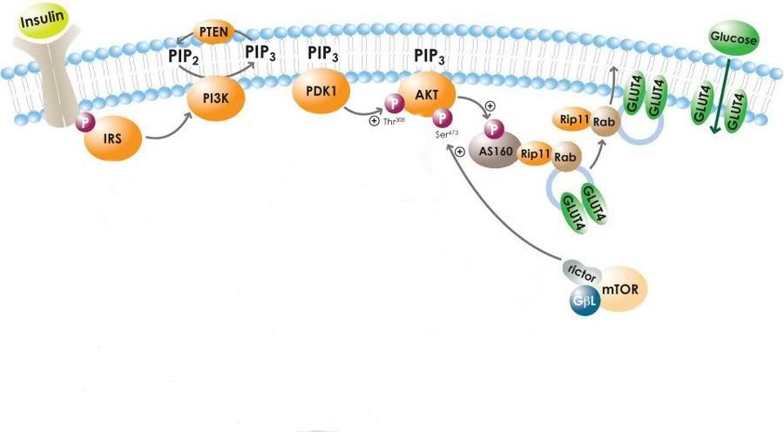
Insulin signaling
May, 2010
Glucocorticoids increase glucose, insulin, but lower glucose uptake.
Putative points of inhibition include IRS 1 and p85.

Slide 38
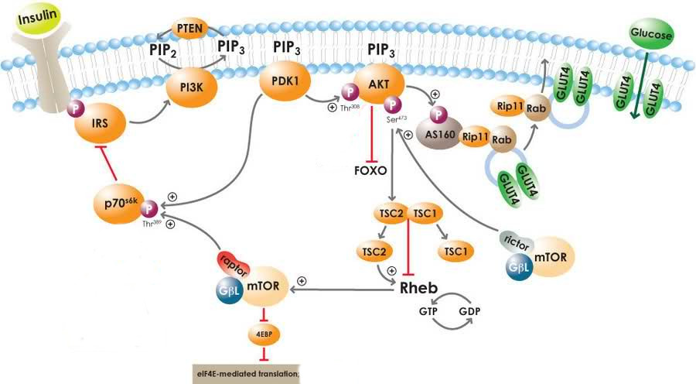
Mechanisms of Akt desensitization

Slide 39
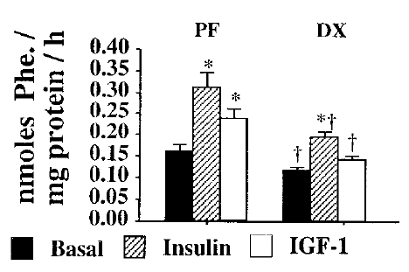
Insulin and IGF-I are equally affected
Dardevet et al., J Endocr, 1998.

Slide 40
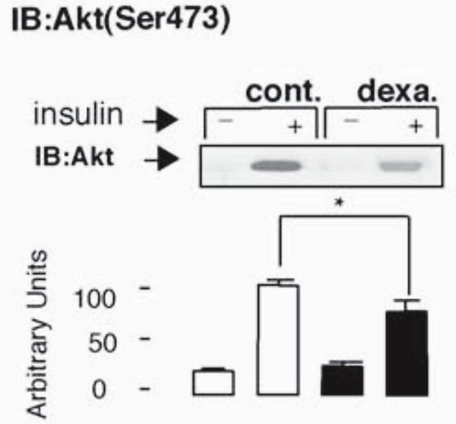
Important caveat: conditions may change results
Rojas et al., Endocrin, 2003.

Slide 41
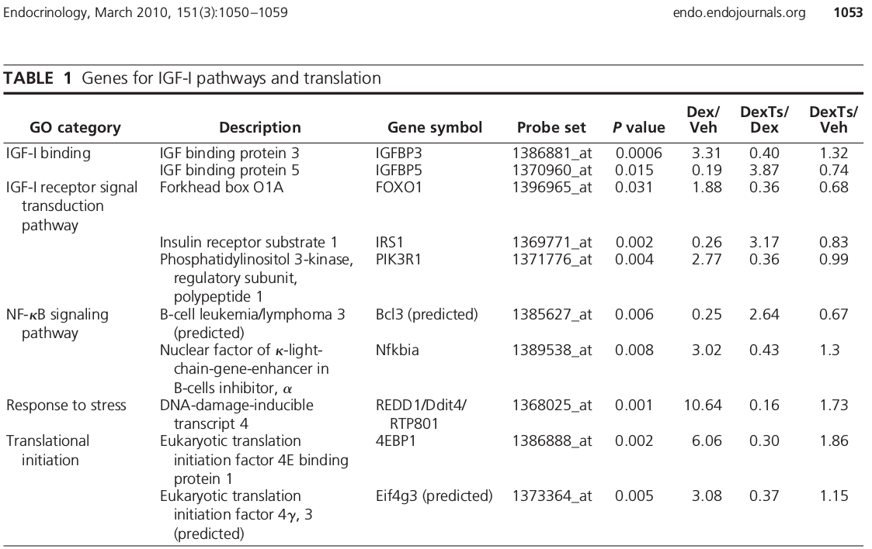
Targets for testosterone alleviation
Wu et al., Endocrinology, 2010.

Slide 42
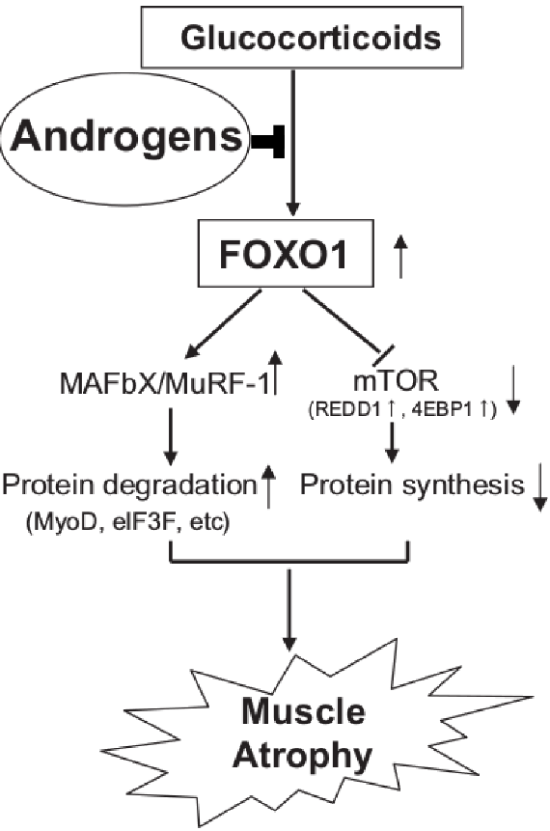
Foxo as mediators of testosterone
Qin et al., BBRC, 2010.
Wu et al., Endocrinology, 2010.

Slide 43
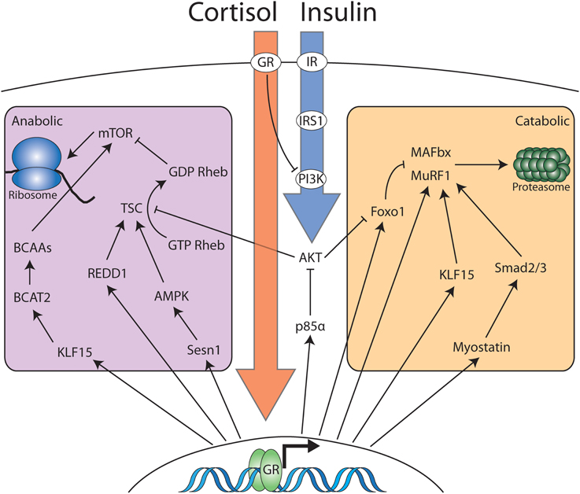
Insulin / IGF-I could be the Foxo-overruling factor
Braun and Jones, Front Physiol, 2015.

Slide 44
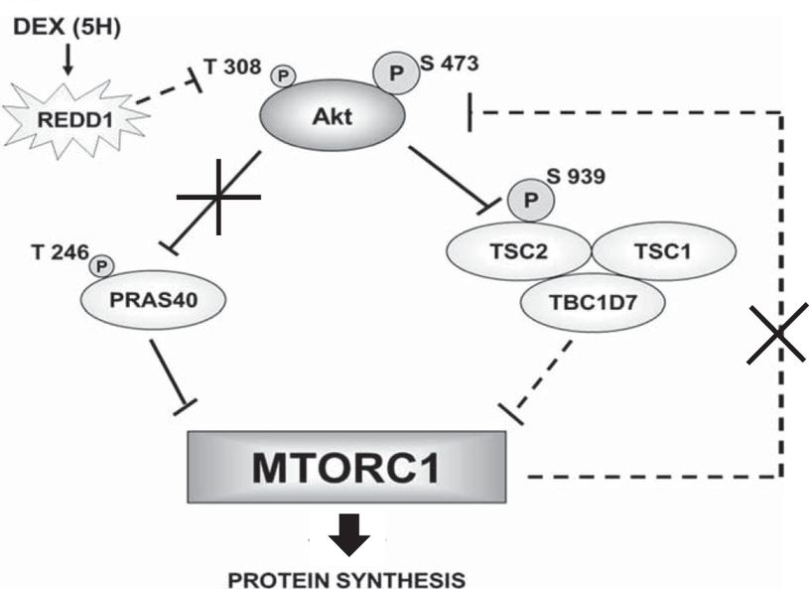
REDD1 could help with Akt desensitization
Britto et al., Am J Physiol, 2014.

Slide 45
Third hypothesis
Testosterone’s myoprotective action in glucocorticoid-induced loss of muscle mass is facilitated by a restoration of Foxo signaling, mediated by IGF-I and / or REDD1.

Slide 46
Testosterone pushes the transcriptional lever
quadriceps Foxo3a mRNA
quadriceps Klf15 mRNA
one day
three days
seven days

Slide 47
IGF-I is partly restored by testosterone co-administration
quadriceps
IGF-I Ea mRNA
one day
three days
seven days

Slide 48
Testosterone partly reverses REDD1 upregulation
gastrocnemius
REDD1 mRNA
quadriceps
REDD1 mRNA
one day
three days
seven days

Slide 49
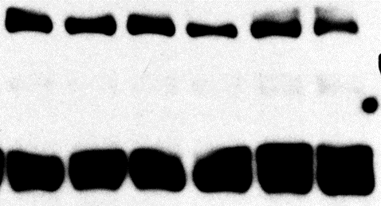
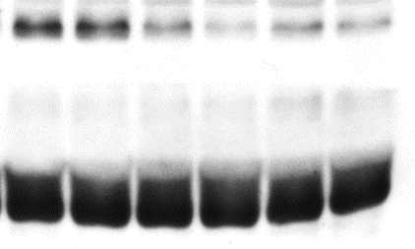
Akt (Ser 473) does not respond to testosterone
total Akt
Ⓟ473-Akt
GAPDH
GAPDH
Dexa | — | — | + | + | + | +
Testo | — | — | — | — | + | +
Dexa | — | — | + | + | + | +
Testo | — | — | — | — | + | +
total Akt
Ⓟ473-Akt
Ⓟ473-Akt /
total Akt
Gastrocnemius, 7 day.

Slide 50
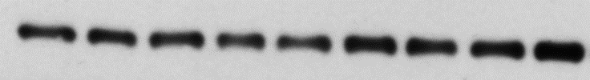
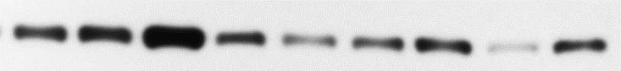
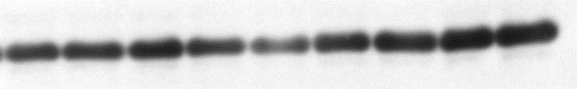
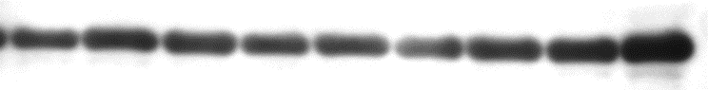
Akt (Ser 473) does not respond to testosterone in hypersensitive levator
total Akt
Ⓟ473-Akt
GAPDH
GAPDH
Dexa | — | — | — | + | + | + | + | + | +
Testo | — | — | — | — | — | — | + | + | +
Dexa | — | — | — | + | + | + | + | + | +
Testo | — | — | — | — | — | — | + | + | +
total Akt
Ⓟ473-Akt
Ⓟ473-Akt /
total Akt

Slide 51
Conclusions so far
Testosterone’s protective action is associated with restoration of Foxo signals.
Transcriptional mediators Klf15 and Foxo are altered by testosterone.
REDD1 and IGF-I are partly restored by testosterone.
Basal state repression of Akt by dexamethasone appears unchanged by testosterone co-administration.

Slide 52
Hypotheses
Testosterone alleviates dexamethasone-induced muscle atrophy in mice.
Testosterone’s myoprotective action in the context of dexamethasone-induced atrophy is based on inhibiting the latter’s proteolytic effects.
Testosterone’s myoprotective action in glucocorticoid-induced loss of muscle mass is facilitated by a restoration of Foxo signaling, helped by IGF-I and / or REDD1 changes.
√
√
…

Slide 53
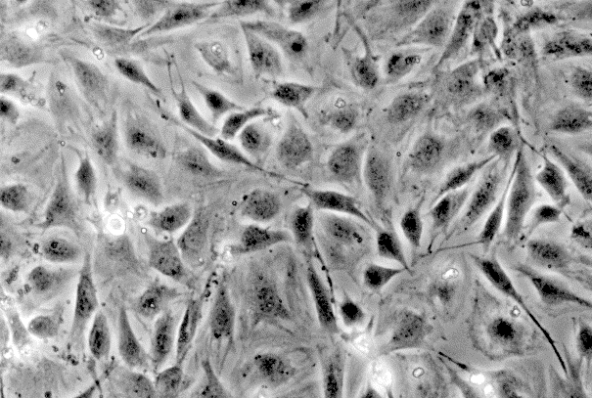
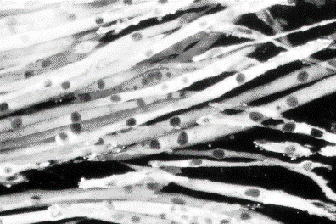
Dexa is anabolic, pro-proliferative for the undifferentiated muscle cells
Start differentiation
Serum-free medium
Time
(days)
Undifferentiated
Differentiated
Many studies discuss effect of the glucocorticoids or combination on proliferating or differentiating cells.

Slide 54
Previous in vitro models
Rat cell studies brought us:
dexamethasone-induced proteolysis
constitutively active and dominant negative Foxo in IGF-I context
LC3 accumulation.
Mouse cell studies are scarce.

Slide 55


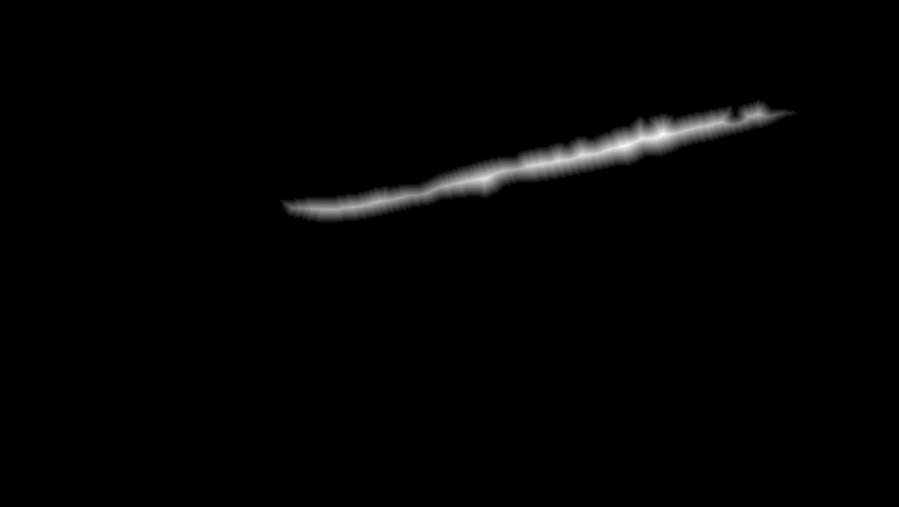
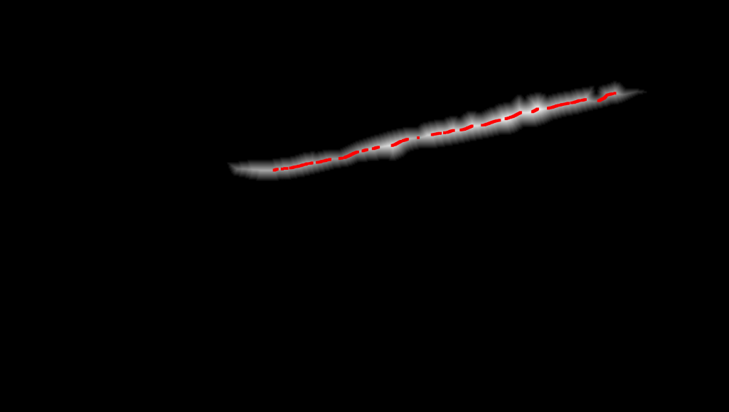
Novel computer-assisted analysis
(B) Matlab
(A) Photoshop

Slide 56
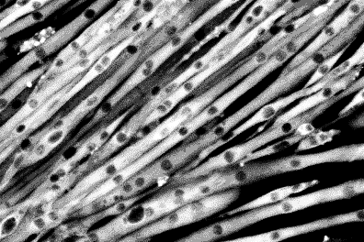
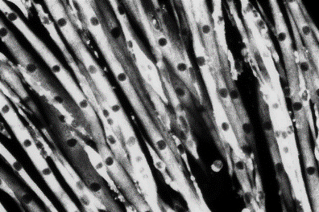
Cell diameter is rescued by testosterone co-administration
Start differentiation
Start pharmacological treatments
Diff. M.
±T±D
Time
(days)
Vehicle
Differentiated
average cell diameter (rel. u.)
50 µM Dexa
Dexa +
300 nM Testo

Slide 57
Total protein content is restored by testosterone co-administration
Start differentiation
Start pharmacological treatments
1 d
Diff. M.
±T±D
Time
(days)
2 d
Diff. M.
±T±D
total protein (normalized to first day)
At 48 hour, statistically significant difference between Dexa and Veh.
At 48 hour, statistically significant difference between Dexa and Dexa + Testo.

Slide 58
First hypothesis
Testosterone alleviates dexamethasone-induced muscle atrophy in mouse cells.
√

Slide 59
Assaying protein synthesis in vitro
Start differentiation
Start pharmacological treatments
Diff. M.
0 d
±T±D
Time
(days)
³H-Phe
Diff. M.
1 d
±T±D
³H-Phe
Diff. M.
2 d
±T±D
³H-Phe
Diff. M.
3 d
±T±D
³H-Phe
Preliminary studies showed lack of sensitivity for 4h and 30h.

Slide 60
Protein synthesis exhibits paradoxical, late increase
tracer enrichment
in cell protein
(fmol/g)
At 72 hour, statistically significant difference between Dexa and Veh.
At 72 hour, statistically significant difference between Dexa and Dexa + Testo.
No change in pattern if normalization is foregone.

Slide 61
Assaying protein degradation in vitro
Start differentiation
Start pharmacological treatments
Diff. M.
Time
(days)
0 d
±T±D
³H-Phe
Diff. M.
1 d
±T±D
³H-Phe
Diff. M.
2 d
±T±D
³H-Phe
Diff. M.
3 d
±T±D
³H-Phe
Preliminary studies showed very low tracer uptake past 48 hour.

Slide 62
Protein degradation correlates with phenotype
medium to cell protein tracer ratio
At 24 hour, statistically significant difference between Dexa and Veh.
At 24 hour, statistically significant difference between Dexa and Dexa + 500 nM Testo.

Slide 63
Second hypothesis
Testosterone’s myoprotective action in the context of dexamethasone-induced atrophy is based on inhibiting the latter’s proteolytic effects.
√

Slide 64
Inhibitor tests in vitro
Protein
labeling
Start steroid
treatments
Start
differentiation
Diff. M.
Time (days)
±T±D
³H-Phe
Collection of measured medium

Slide 65
Proteasome is responsible for bulk digestion
medium to cell protein tracer ratio
Strongest inhibition of proteolysis with proteasome inhibitor MG132.
Non-negligible effect of lysosome inhibitor chloroquine.
Repression to basal level with T co-administration.
IGF1R inhibitor did not alter T effect.

Slide 66
Conclusion
Glucocorticoids
Anabolic steroids
REDD1
IGF-I
Akt
Foxo
MuRF1
proteasome / ubiquitin - mediated catabolism

Slide 67
Future directions
More sensitive assays for Akt.
Better models of IGF-I inhibition.
Mechanistic studies of REDD1 in T co-administration.
In vivo direct measurements of protein synthesis.
More mechanistic studies of autophagy.

Slide 68
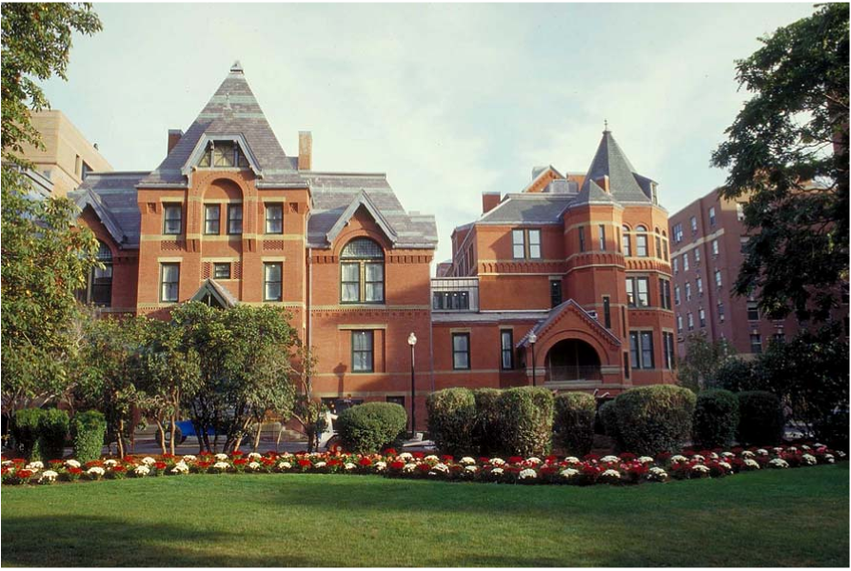
Acknowledgements

